Slide 1




Project
Presentation

Slide 2

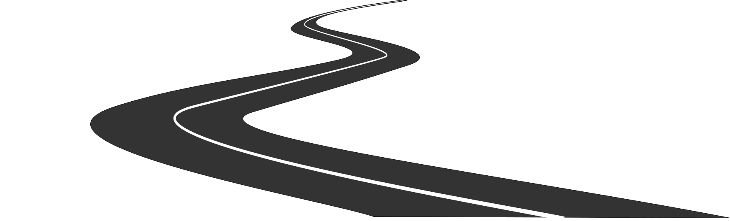
CAR DRIVING ASSISTANT

Slide 3
Team Members
▪︎Tharun NV[124CS0067]
▪︎ Tharun B[124CS0088]
▪︎ Hasini[124CS0086]
▪︎ Nikhil[524EC0015]
▪︎ Siddhartha[124AD0053

Slide 4
Introduction
The Car Driving Assistant System is an innovative project designed to enhance vehicle safety and driving convenience. It uses ultrasonic sensors to measure the distance on both sides of the car, enabling the vehicle to take automatic actions based on these measurements. The system aims to assist the driver by providing real-time distance data and facilitating automatic turning maneuver.

Slide 5
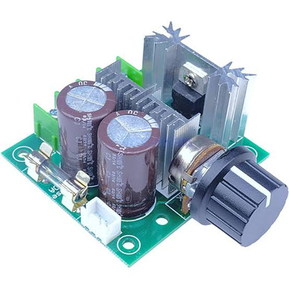
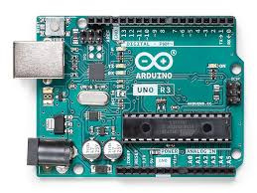
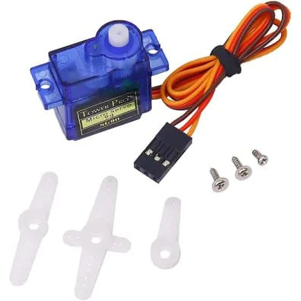
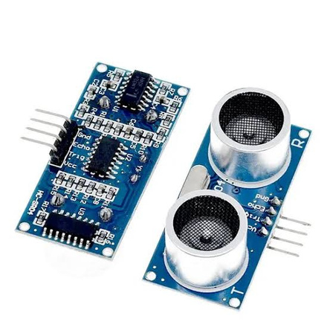
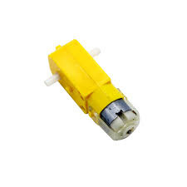
components used

Slide 6

working principle
The vehicle’s direction depends on the distance between the outer fence and side of the vehicle.
Two Ultra Sonic Sensors are attached on either side of the vehicle to measure the distances.
Distance parameters:
L (left side of the vehicle)
R (right side of the vehicle)
W (width of the vehicle)

Slide 7
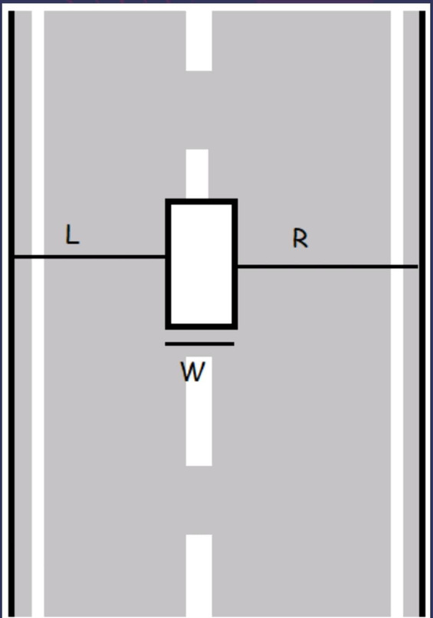
straight path
On the straight path, these distance parameters would not change.
A central processor takes these parameters from sensors, processes the data. As these parameters would not change, it assumes the path is straight and would not change the direction

Slide 8
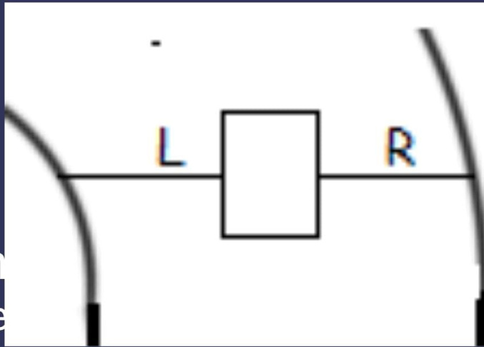
curved path
Turning to Left side:
As the path turns to the left, the left-side distance increases and the right-side distance decreases.
The processor calculates the amount of angle needed to rotate to maintain the vehicle on the path.
This information is sent to the servo motor. It changes the direction of the vehicle.

Slide 9
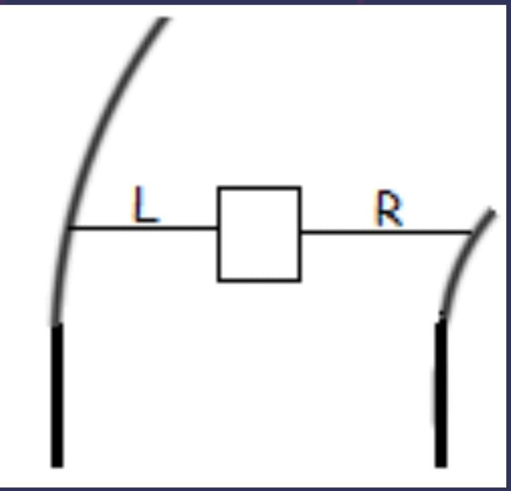
curved path
Turning to Right side:
As the path turns to the right, the left-side distance decreases and the right-side distance increases.
So, the angle calculated by the processor will be less than the right angle in a counterclockwise direction.
The degree of the angle depends on the amount of change in the parameters. The car width never changes, only the left and right parameters will change.

Slide 10
/ Arduino code for a car that adjusts its direction based on road curvature using ultrasonic
// sensors and only rear (back) motors
#include<Servo.h>
#define lag 5000 // delay between action
#define change 20 // change of the angle
// Pin assignments
const int trigLeft = 2;
const int echoLeft = 3;
const int trigRight = 4;
const int echoRight = 5;
const int servopin = 9;
const int leftled = 10;
const int rightled = 11;
Servo myservo;
CODE

Slide 11
/ Function to measure distance using ultrasonic sensor
long measureDistance(int trigPin, int echoPin) {
digitalWrite(trigPin, LOW);
delayMicroseconds(2);
digitalWrite(trigPin, HIGH);
delayMicroseconds(10);
digitalWrite(trigPin, LOW);
long duration = pulseIn(echoPin, HIGH);
long distance = duration * 0.034 / 2; // Convert to cm
return distance;
}
// Functions to control rear motors
void moveForward() {
myservo.write(70);
delay(lag);
}
CODE

Slide 12
void turnLeft() {
myservo.write(70 - change);
digitalWrite(leftled, HIGH);
delay(lag);
digitalWrite(leftled, LOW);
myservo.write(70);
}
void turnRight() {
myservo.write(70 + change);
digitalWrite(rightled, HIGH);
delay(lag);
digitalWrite(rightled, LOW);
myservo.write(70);
}
void setup() {
Serial.begin(9600);
pinMode(trigLeft, OUTPUT);
pinMode(echoLeft, INPUT);
pinMode(trigRight, OUTPUT);
pinMode(echoRight, INPUT);
}
void loop() {
long distanceLeft = measureDistance(trigLeft, echoLeft);
long distanceRight = measureDistance(trigRight, echoRight);
Serial.print("Left: ");
Serial.print(distanceLeft);
Serial.print(" cm, Right: ");
Serial.print(distanceRight);
Serial.println(" cm");
int difference = distanceLeft - distanceRight;
if (difference < 0) {
turnRight(); // Move straight using rear motors
} else if (difference > 0) {
turnLeft(); // More space on left, turn right
} else {
moveForward(); // More space on right, turn left
}
}

Slide 13
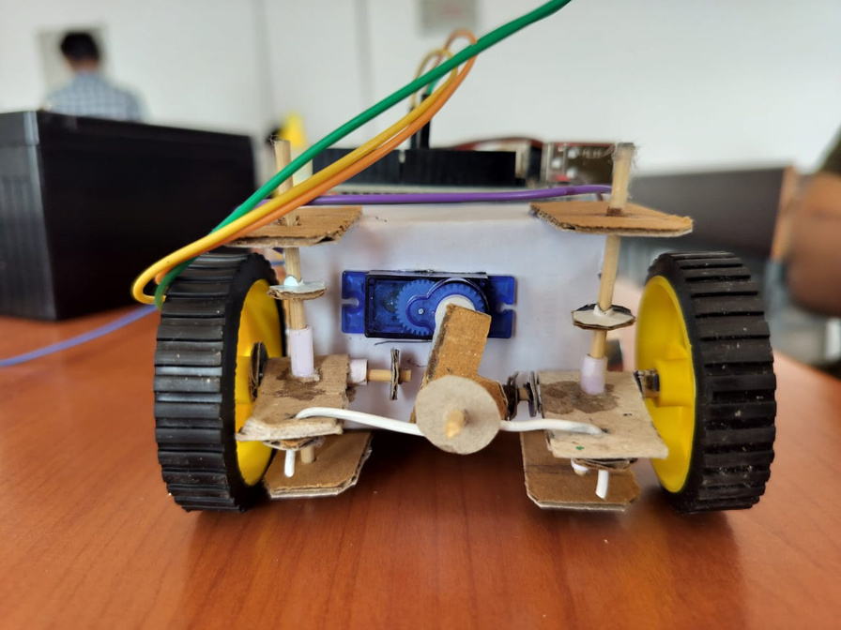
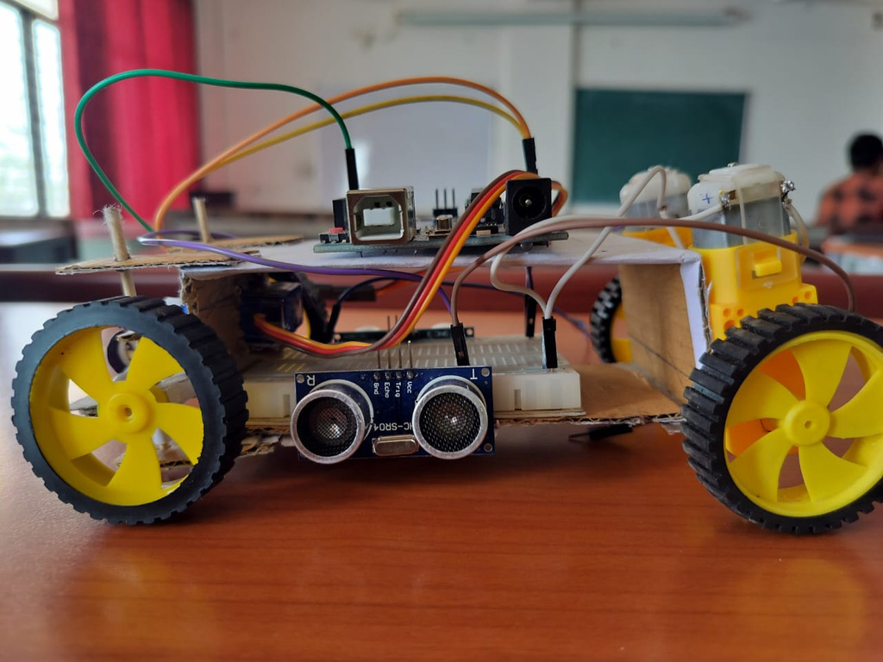
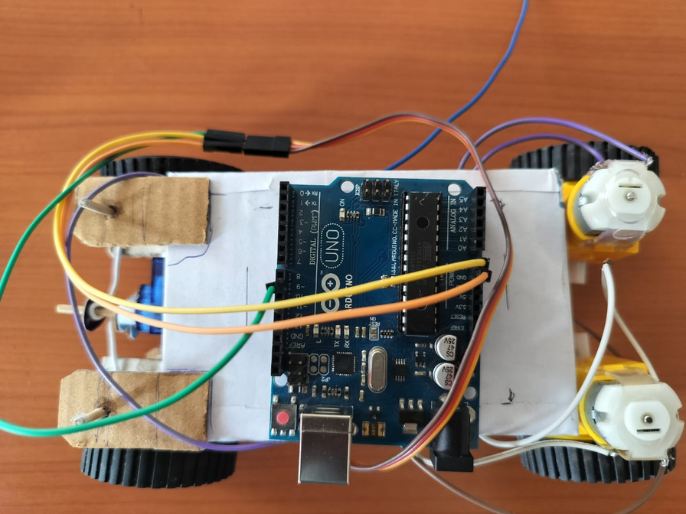
PROTOTYPE

Slide 14
Thank You

